Slide 1
Image Enhancement Using Homomorphism Filtering
Nithin
2019/01/04

Slide 2
Outline
Motivation
Homomorphic filtering
Introduction
Proposed Method
Implementation
Simulation Graph
Conclusion

Slide 3
Motivation
It is annoying, if some important image is blur or unclear.
How to normalizes the brightness and contrast across an image.
Several image DE noising/enhancement.
Techniques in literature but few for colour image.

Slide 4
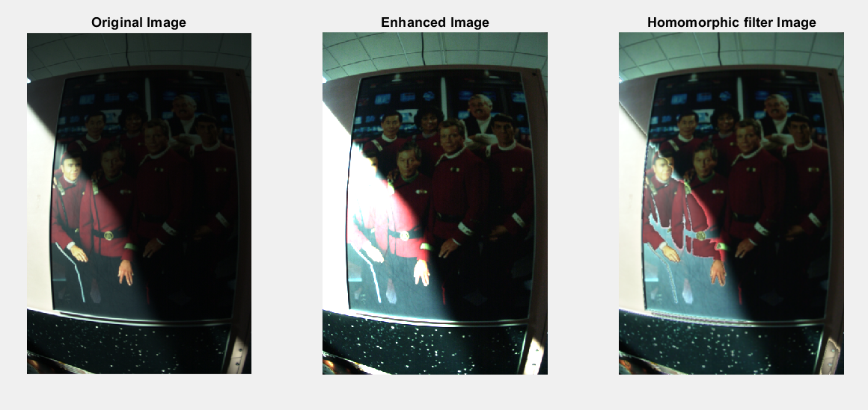
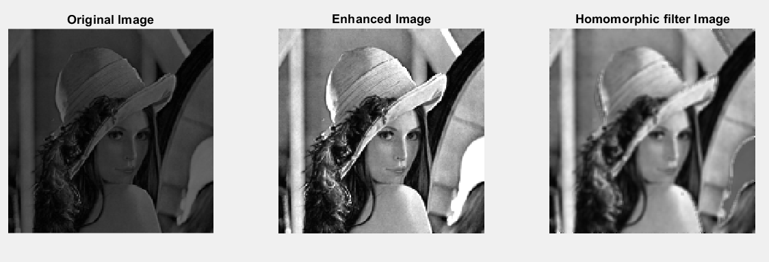
Homomorphic Filtering…(1)
Olden days of image processing called homomorphic filtering.
Remove shading effects from an images(Due to uneven illumination).
Enhance high frequencies.
Attenuate low frequencies but preserve fine details.

Slide 5
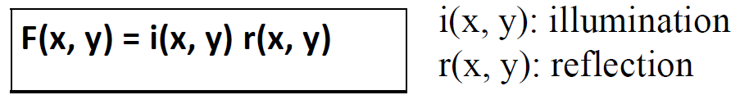
Homomorphic Filtering…(2)
Consider the following model of image formation:-
In general, the illumination component i(x, y) varies slowly and affects low frequencies mostly.
In general, the reflection component r(x, y) varies faster and affects high frequencies mostly.

Slide 6
How are Frequencies Mixed Together?
Low and high frequencies from i(x, y) and r(x, y) are mixed together.
For filtering, it is difficult to handle low/high frequencies separately.

Slide 7

Can we Separate Them?
Idea
Take the ln( ) of

Slide 8
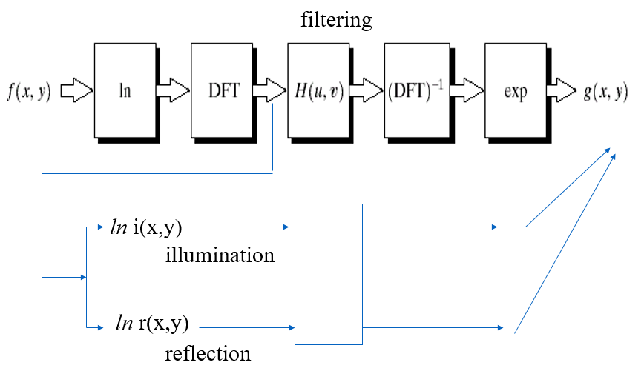
Homomorphic Filtering Approach

Slide 9


Implementation…(1)
(1) Take
(2) Apply FT:
Low-pass filter
High-pass filter

Slide 10

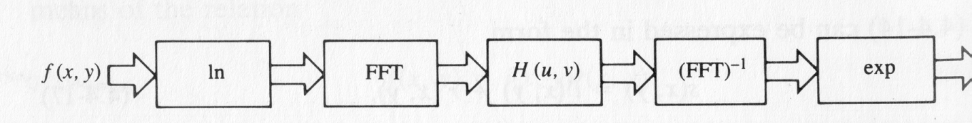
Implementation…(2)
(3) Apply H(u, v)
(4) Take Inverse FT
Take exp( ):

Slide 11
Homomorphic Filtering: Experiment-1

Slide 12
Homomorphic Filtering: Experiment-2

Slide 13
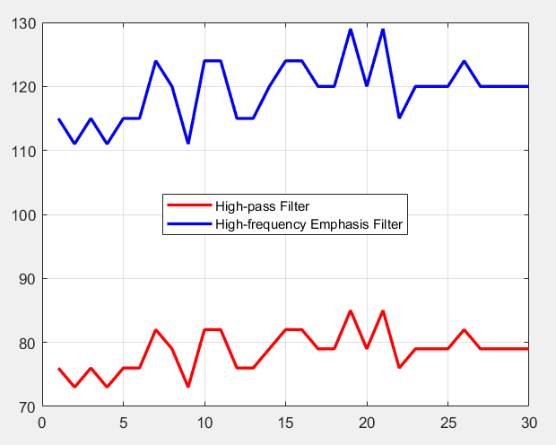
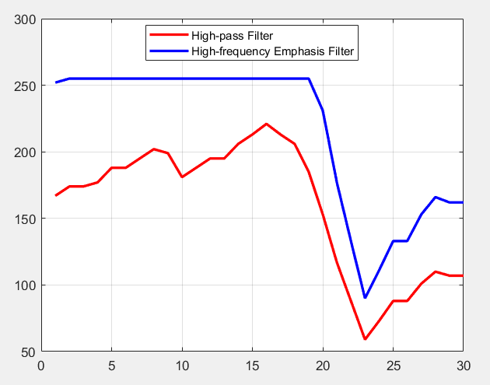
High-pass Filter Vs High-frequency Emphasis
Experiment-1
Experiment-2

Slide 14
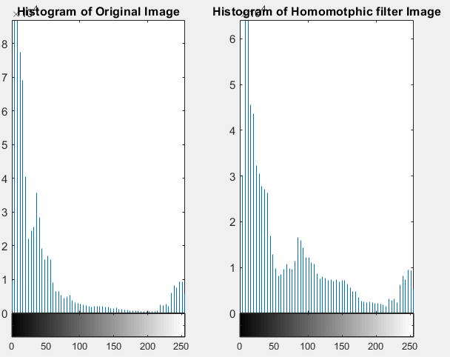
Histogram of Experiment-1

Slide 15
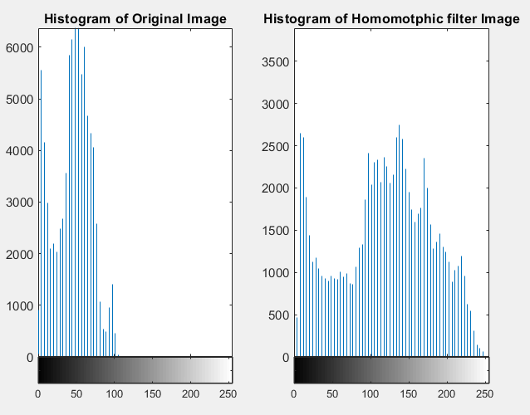
Histogram of Experiment-1

Slide 16
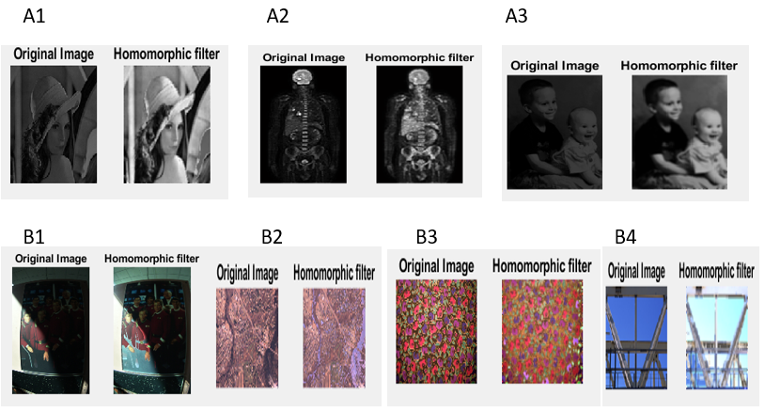
Dataset-1

Slide 17
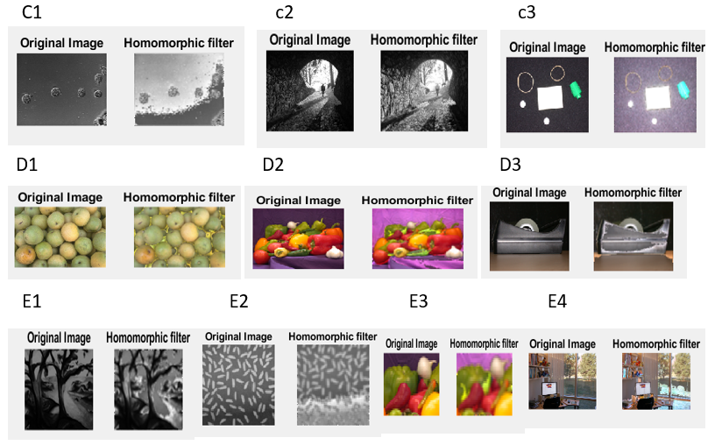
Dataset-2

Slide 18
Conclusion
Blur image to fine image improve for much clear visualization
The brightness is modified the brightness in high frequency and in low frequency, we improved the result by using homomorphic filtering and we get acceptable result of some fidelity parameter.
Balance between uneven illumination.
Homomorphic filter.

Slide 19
References
Abbas, Assist Prof Amel H., and Jamila Harbi. "Image Enhancement By Using Homomorphic Filtering Model." The 1st International Conference on Information Technology (ICoIT'17). 2017.

